Slide 1
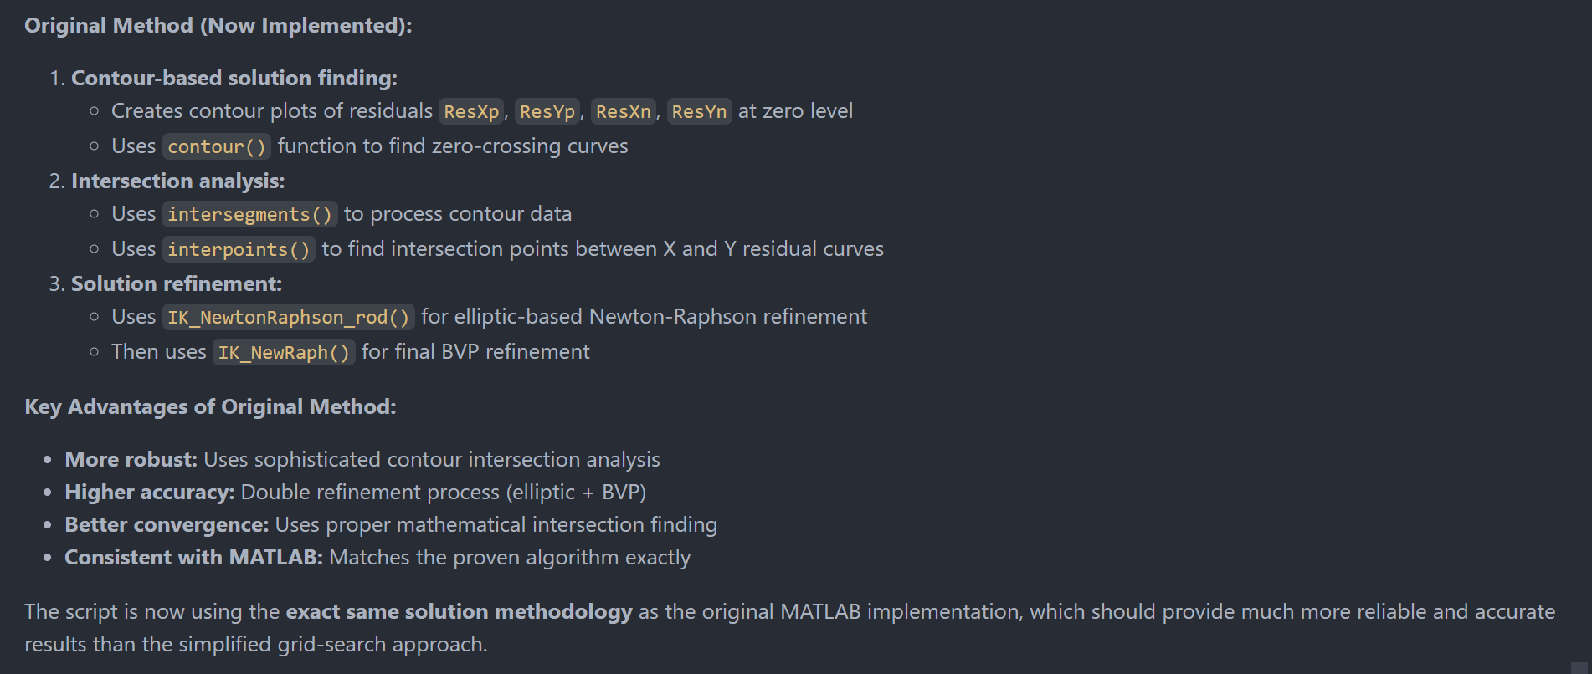
01-elliptical-rod-solver.jl
MATLAB script AA_IK_ClampedPinned_Rod_Elliptical.m

Slide 2
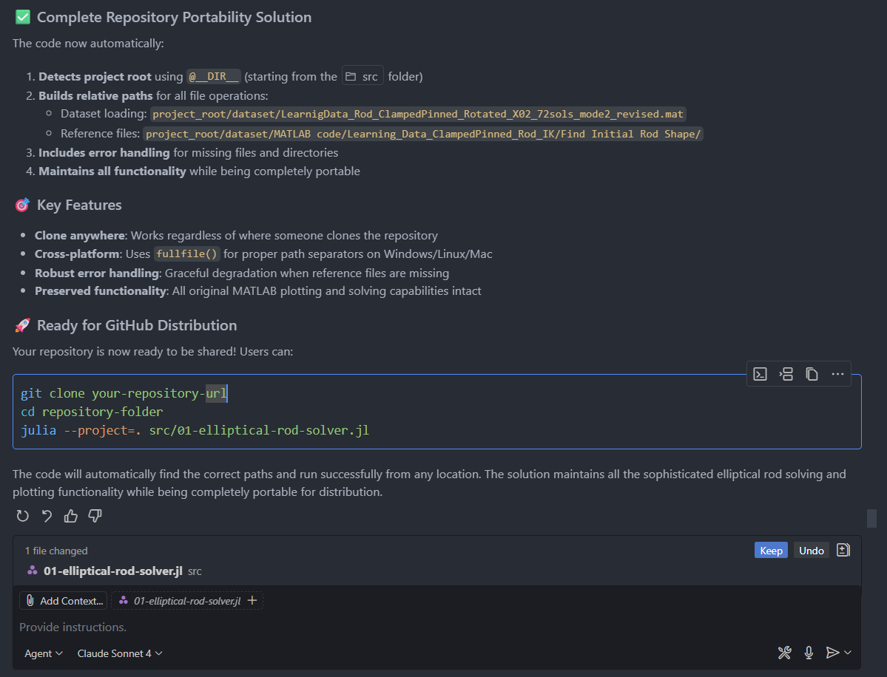

Slide 3
